Slide 1
FACIAL EMOTION RECOGNITION
By Abdullah & Abdulrahman

Slide 2
TABLE OF CONTENTS
01
02
03
DATA
MODELS
CONCLUSION
Backstory
Data set
Tools
Data Processing
Baseline model
Simple NN, NN
Simple CNN, CNN
Final model

Slide 3
BACKSTORY
Humans are capable of conveying many emotions through their faces.
Emotion recognition is the process of identifying human emotion.
Technology can be used to recognize these emotions.

Slide 4
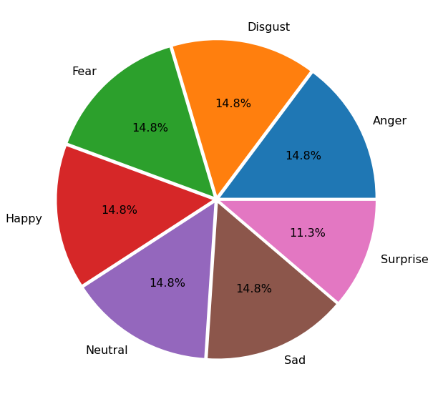
DATASET
Facial Emotion Recognition.
From Kaggle.
37,303
Multilabel:
Neutral
Happy
Sad
Surprise
Fear
Disgust
Anger
Colored
Balanced
Different sizes

Slide 5







TOOLS

Slide 6
PROJECT WORKFLOW
DATA READING
DATA AUGMENTATION
BASELINE MODELS
MODELS
Reading images using
TensorFlow
Resize images
Scaling
Flip images
Rotate Images
Sample images.
Data classes graph.
CNN Model
Transfer Learning

Slide 7
DATA AUGMENTATION
Resize Images (180x180)
Scaling/Normalization (1 to 255)
Randomly Rotate Images (up to 20°)
Randomly Flip Images (Horizontally)
Train
Validation
Test
90%
5%
5%

Slide 8
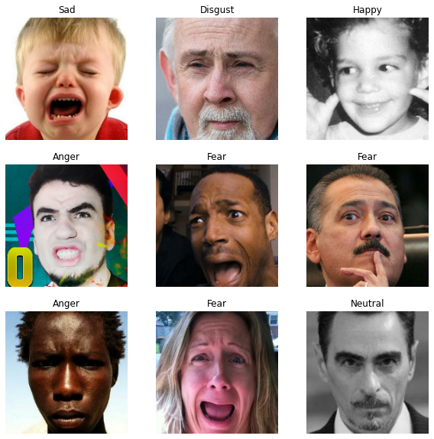
DATA SAMPLE

Slide 9
BASELINE MODELS
1
2
3
Simple NN
NN
Simple CNN
Hidden layers: 1
Dense: 16
Activation: ReLU
Optimizer: ADAM, SGD
Hidden layers: 7
Dense: 8 - 64 - 8
Activation: ReLU, tanh
Optimizer: ADAM, SGD
Hidden layers: 2
Filters: 20 , 10
Activation: ReLU, tanh
Padding: Same
Optimizer: ADAM, SGD
Loss function: Sparse Categorical Crossentropy
Output Activation: SoftMax

Slide 10
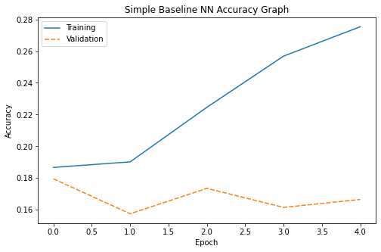
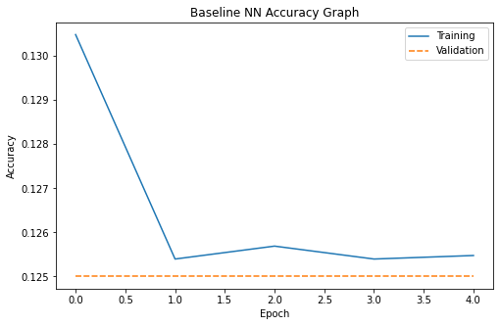
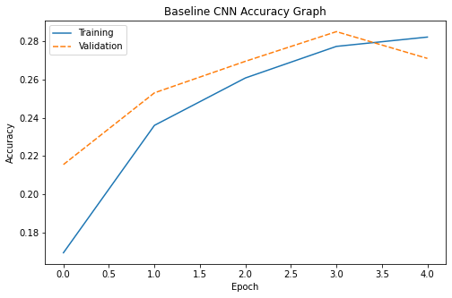
BASELINE MODEL GRAPHS
Simple NN
Neural Network
Simple CNN
Train Accuracy: 30.89%
Validation Accuracy: 16.65%
Difference: 14.24
Train Accuracy: 13.31%
Validation Accuracy: 12.5%
Difference: 0.81
Train Accuracy: 29.36%
Validation Accuracy: 27.09%
Difference: 2.26

Slide 11
MAIN MODELS
CNN
DenseNet
VGG-16
Hidden layers : 7
Filters : 32-64-128-256
Strides : 2
Kernel Size : 3
Kernel Regularize : L2()
Spatial Dropout : 0.4
BatchNormalization
Activation : ReLU , tanh.
Padding : Same
Optimizer : adam , SGD
Layers added : 2
Dense : 256 - 128
BatchNormalization
Activation : ReLU .
Optimizer : adam
Weights : imagenet
Include Top : False
Layers added : 2
Dense : 256 - 256
BatchNormalization
Activation : ReLU.
Optimizer : adam
Weights : imagenet
Include Top : False
Loss function: Sparse Categorical Crossentropy
Output Activation: SoftMax

Slide 12
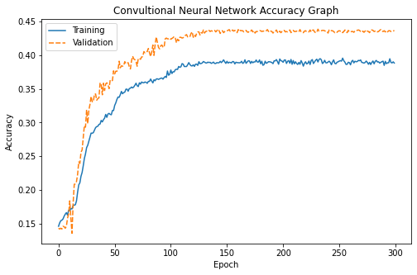
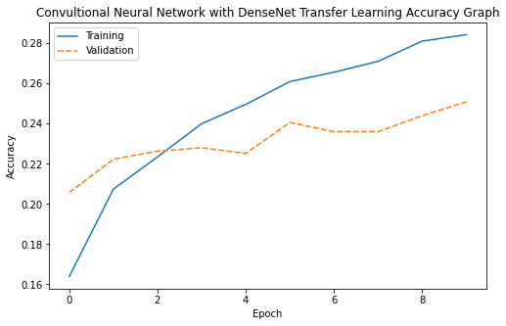
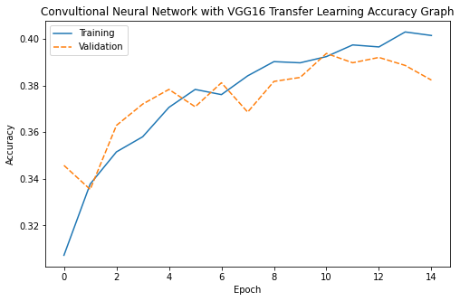
MAIN MODEL GRAPHS
CNN
DenseNet
VGG-16
Train Accuracy: 45.44%
Validation Accuracy: 43.65%
Difference: 1.78
Train Accuracy: 29.92%
Validation Accuracy: 25.08%
Difference: 4.84
Train Accuracy: 42.00%
Validation Accuracy: 38.22%
Difference : 3.77

Slide 13
MAIN MODELS
VGG-19
InceptionV3
ResNet50
Layers added : 2
Last two layers are trainable
Dense : 256 – 256
GlobalAveragePooling2D()
BatchNormalization
Activation : ReLU.
Optimizer : adam
Weights : imagenet
Include Top : False
Layers added : 2
Last layer is trainable
Dense : 256 – 256
GlobalAveragePooling2D()
BatchNormalization
Activation : ReLU .
Optimizer : adam
Weights : imagenet
Include Top : False
Layers added : 2
Last layer is trainable
Dense : 512 – 256
GlobalAveragePooling2D()
BatchNormalization
Activation : ReLU.
Optimizer : adam
Weights : imagenet
Include Top : False
Loss function: Sparse Categorical Crossentropy
Output Activation: SoftMax

Slide 14
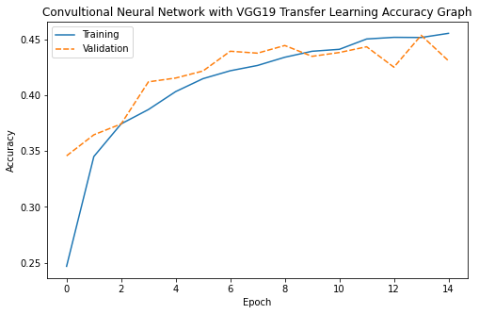
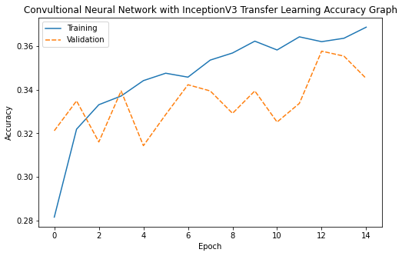
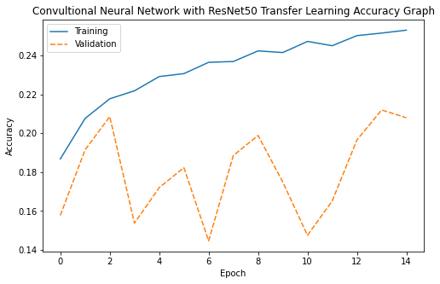
MAIN MODEL GRAPHS
VGG-19
InceptionV3
ResNet50
Train Accuracy: 47.81%
Validation Accuracy: 43.08%
Difference: 4.72
Train Accuracy: 38.08%
Validation Accuracy: 34.51%
Difference: 3.57
Train Accuracy: 18.51%
Validation Accuracy: 20.80%
Difference: 2.28

Slide 15
CONCLUSION
Final Model
Future Work
VGG19 Transfer Learning
Layers added: 5
Last two layers are trainable
Dense: 128 – 128
GlobalAveragePooling2D
Dropout
Activation: ReLU.
Optimizer: ADAM
Weights: imagenet
Include Top: False
Train Accuracy: 48.52%
Test Accuracy: 45.14%
Improve model accuracy by tuning Neural Network
Train + Validation
95%
Test
5%

Slide 16
THANKS FOR LISTENING

